Slide 1

High-Level Synthesis for Edge-AI Applications
Name | Nader Yahia
Matriculation | 2210026
Supervisor | Prof. Dr.rer.nat. Achim Rettberg

Slide 2
Introduction
What is Edge AI?
Execution of artificial intelligence models directly on edge devices (e.g., sensors, embedded systems, FPGA/SoC), close to the data source [1].
Why Edge AI?
Low latency (real-time response required).
Reduced bandwidth usage (no continuous cloud communication).
Lower system dependency on cloud infrastructure.
Improved privacy (data stays local).
What is Key edge constraints ?
Very low power budget.
Limited memory (on-chip bottlenecks).
Limited communication bandwidth.
Predictable real-time response requirements.
FPGAs represent a well-suited platform due to their balance of performance, energy efficiency, and reconfigurability [2].

Slide 3
Motivation For HLS
RTL Design Complexity: Manual RTL design is time-consuming and requires high expertise.
Low Design Productivity: Long development cycles limit fast prototyping and iteration.
Need for Design Space Exploration: Rapid evaluation of optimizations (PIPELINE, UNROLL, PARTITION).
Bridging Software–Hardware Gap: HLS bridges C/C++ algorithm design with FPGA RTL implementation.
Faster Time-to-Deployment: HLS accelerates prototyping and iteration for Edge AI applications.
[3]

Slide 4
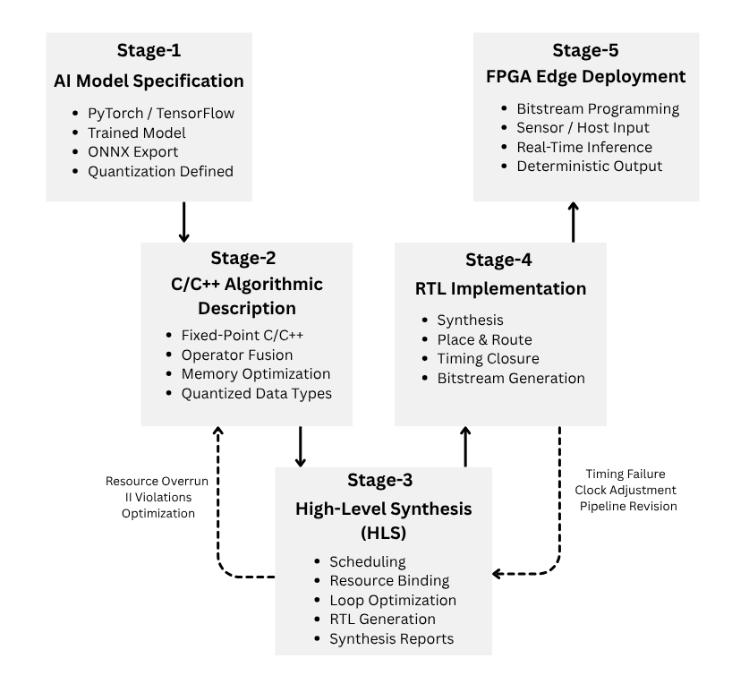
Model-to-Deployment Pipeline
Stage 1: AI Model trained and exported (ONNX, quantized).
Stage 2: C/C++ fixed-point model with optimizations.
Stage 3: HLS converts C/C++ → RTL with scheduling & synthesis.
Stage 4: RTL implementation (place & route, timing closure).
Stage 5: FPGA-based accelerator executes AI inference.
Fig.1 : Model-to-Deployment Pipeline
[1],[5]

Slide 5
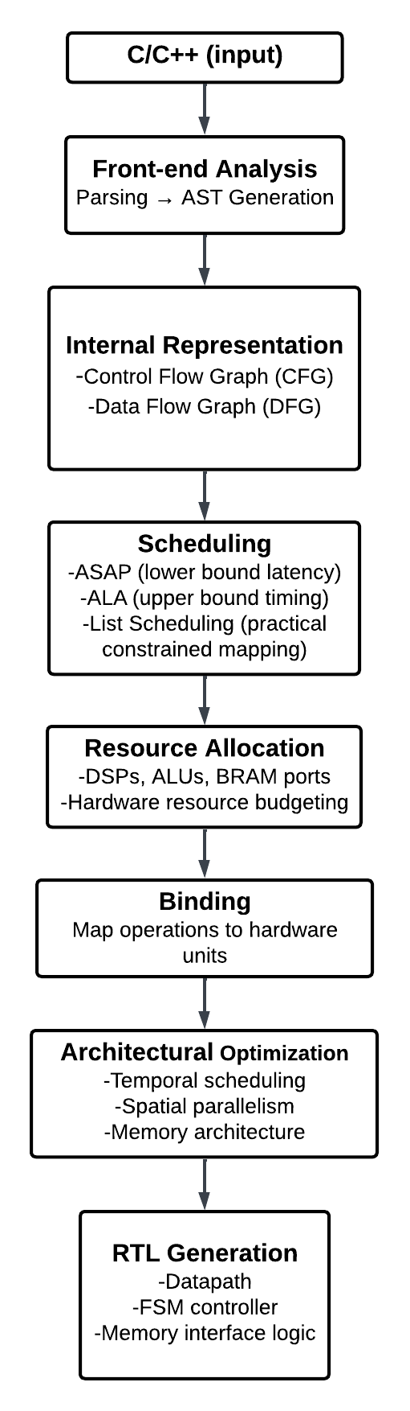
HLS Compilation Flow
1. Code Parsing
C/C++ → Abstract Syntax Tree (AST).
2. CFG/DFG Graph Construction
CFG: describes execution control (loops, branches)
DFG: describes computation dependencies
3. Scheduling
DFG → Scheduled DFG.
Assigns each operation to a clock cycle.
4. Resource Allocation + Binding (Hardware Mapping)
Scheduled DFG → Hardware Mapping.
Allocation: number of DSPs, ALUs, memory ports.
Binding: Assign operations → specific hardware units.
Fig.2: HLS Compilation Flow

Slide 6
HLS Compilation Flow
5. Loop Optimizations (Parallelism Extraction)
II = initiation interval
Pipelining: overlap loop iterations
Unrolling: replicate loop body → spatial parallelism
Dataflow: pipeline entire system into stages
Trade-offs
Latency ↔ Throughput ↔ Area (DSP/LUT/BRAM usage).
6. RTL Generation (Final Hardware)
Mapped Graph → RTL (Verilog/VHDL)
Datapath: DSPs, registers, multiplexers
Control: FSM derived from schedule
Memory: BRAM / DRAM interface logic
Behavioral model → fully synthesizable FPGA architecture
[3]
Fig.2: HLS Compilation Flow

Slide 7
Implementation Methodology
Objective
Accelerate a CNN 2D convolution kernel using HLS.
Optimization Flow
Baseline
Pipeline
Unroll
Development Environment | Evaluation Metrics
Artix-7 (xc7a100t-csg324-1) | Clock period
Vitis HLS 2022.2 | Latency
C/C++ HLS | DSP utilization
100 MHz (10 ns constraint) | LUT utilization
Vivado IP Flow Target | FF utilization

Slide 8
Results
Performance Comparison
Metric | Baseline | PIPELINE | UNROLL
Clock (ns) | 7.11 | 7.29 | 6.90
Latency (ms) | 22.176 | 10.368 | 3.600
DSP | 1 | 144 | 36
LUT | 760 | 7705 | 6466
FF | 260 | 3123 | 5691
Key observations
PIPELINE reduced latency by approximately 53%.
UNROLL reduced latency by approximately 84%.
Both optimizations increased hardware resource utilization.
UNROLL achieved the best performance-resource balance in this study.

Slide 9
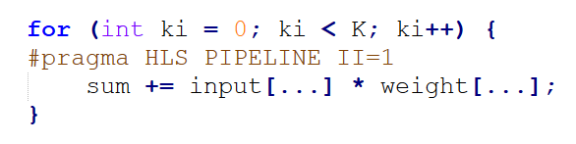
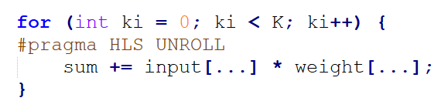
Discussion
Baseline Model (Sequential)
Each MAC is executed one after another.
one shared multiplier and adder used.
Highest latency and least resources utilized
Pipeline Model
Next MAC starts before previous finishes.
Operations are overlapped in time.
Latency: 22.17 ms → 10.36 ms (↓ ~53%)
DSP: 1 → 144 (↑)
Unroll Model
All MAC operations inside loop run in parallel.
Multiple multipliers (DSPs) are instantiated.
Latency: 22.17 ms → 3.60 ms (↓ ~84%)
DSP: 1 → 35 (↑)

Slide 10
Conclusion
Edge AI requires hardware accelerators that deliver high performance under strict power, latency, and resource constraints.
High-Level Synthesis provides a practical design methodology fills the gap of RTL complexity, significantly accelerating the edge AI applications deployment.
CNN convolution was used as a representative Edge AI workload to demonstrate how HLS directives influence hardware architecture and performance.
These obtained results confirm that HLS support methodical hardware design exploration, thereby establishing it as a cornerstone of the Edge AI acceleration FPGA platforms.
[1]–[5]

Slide 11
Refereneces
[1] W. Shi, J. Cao, Q. Zhang, Y. Li, and L. Xu, “Edge computing: Vision and challenges,” *IEEE Internet of Things Journal*, vol. 3, no. 5, pp. 637–646, 2016, doi: 10.1109/JIOT.2016.2579198.
[2] E. Nurvitadhi, G. Venkatesh, J. Sim, and D. Marr, “Can FPGAs beat GPUs in accelerating next-generation deep neural networks?” in Proc. ACM/SIGDA Int. Symp. Field-Programmable Gate Arrays (FPGA), 2017, doi: 10.1145/3020078.3021736.
[3] Advanced Micro Devices Inc. (AMD), *Vitis High-Level Synthesis User Guide*, 2023. [Online]. Available: https://www.amd.com/en/products/software/adaptive-socs-and-fpgas/vitis/vitis-hls.html.
[4] S. Han, H. Mao, and W. J. Dally, “Deep compression: Compressing deep neural networks with pruning, trained quantization and huffman coding,” *Proc. Int. Conf. Learning Representations (ICLR)*, 2016. [Online]. Available: https://arxiv.org/abs/1510.00149.
[5] V. Sze, Y.-H. Chen, T.-J. Yang, and J. S. Emer, “Efficient processing of deep neural networks: A tutorial and survey,” *Proceedings of the IEEE*, vol. 105, no. 12, pp. 2295–2329, 2017, doi: 10.1109/JPROC.2017.2761740.

Slide 12
Q & A

